Slide 1
A Poisson Analysis of Formula 1 Pit Stops
Andrew Estes

Slide 2

Continuous Distributions
Discrete Distributions
Discrete uniform distribution: All outcomes are equally likely
Bernoulli Distribution: Single-trial with two possible outcomes
Poisson Distribution: The probability that an event may or may not occur
Gaussian Distribution: Symmetric distribution of values around the mean
Student t-Test Distribution: Small sample size approximation of a normal distribution
Exponential distribution: Model elapsed time between two events
Notes:
https://datasciencedojo.com/blog/types-of-statistical-distributions-in-ml/

Slide 3
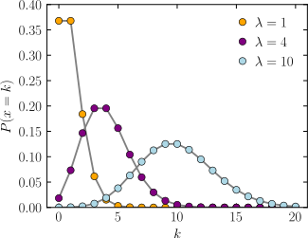
Poisson Distribution as defined by Wikipedia
In probability theory and statistics, the Poisson distribution is a discrete probability distribution that expresses the probability of a given number of events occurring in a fixed interval of time or space if these events occur with a known constant mean rate and independently of the time since the last event.^{[1]} It is named after French mathematician Siméon Denis Poisson (/ˈpwɑːsɒn/; French pronunciation: ​[pwasɔ̃]). The Poisson distribution can also be used for the number of events in other specified interval types such as distance, area, or volume.

Slide 4
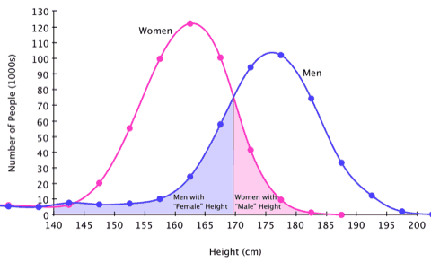
Poisson Distribution Example
Notes:
https://sugarandslugs.wordpress.com/2011/02/13/sex-differences/

Slide 5
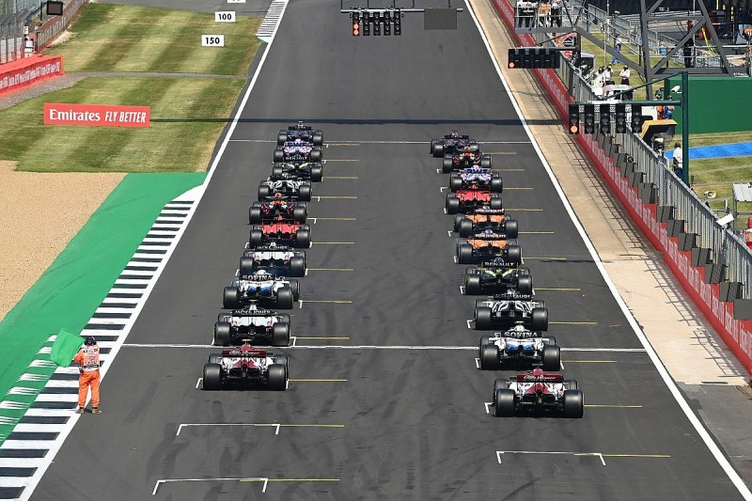
Notes:
Starting formation for the 20 cars, beginning of race

Slide 6
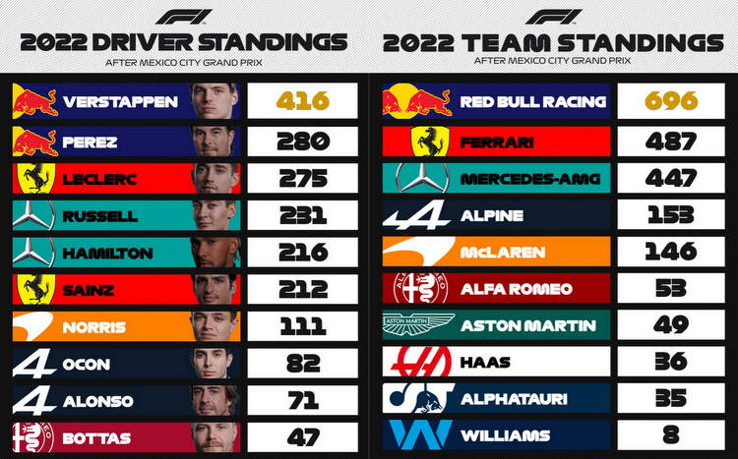

Slide 7
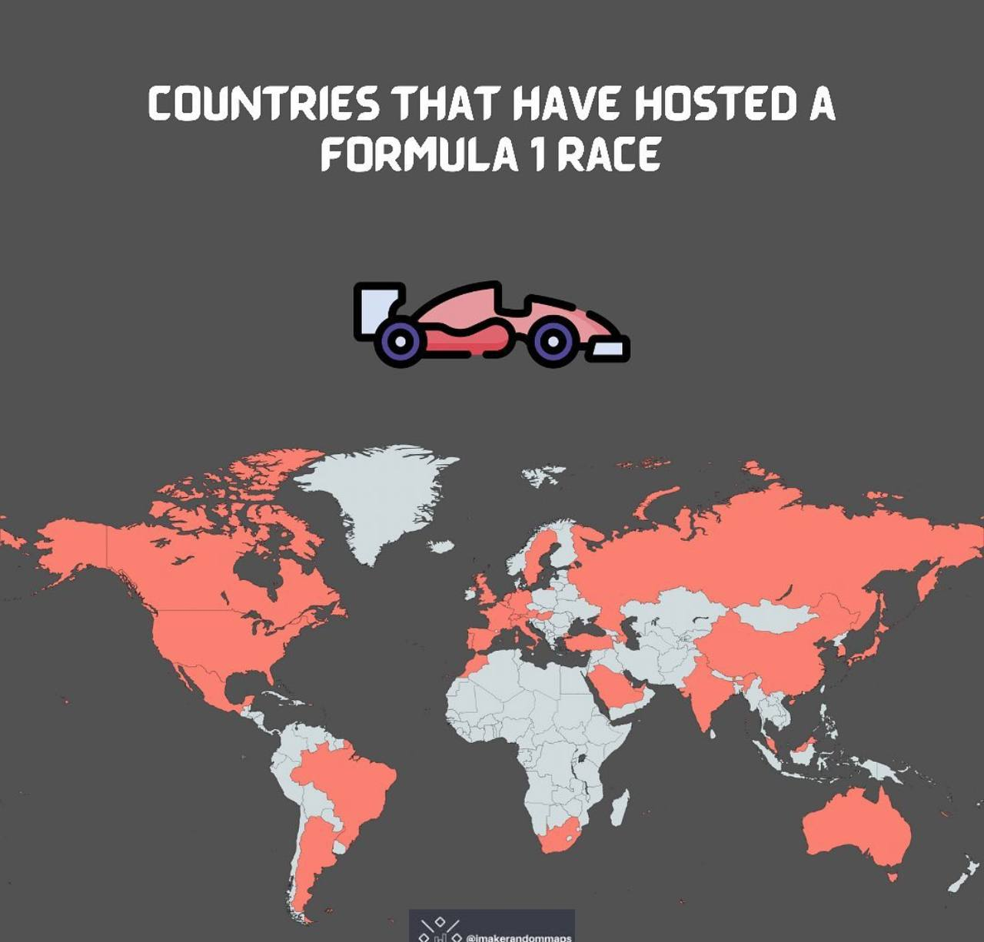

Slide 8
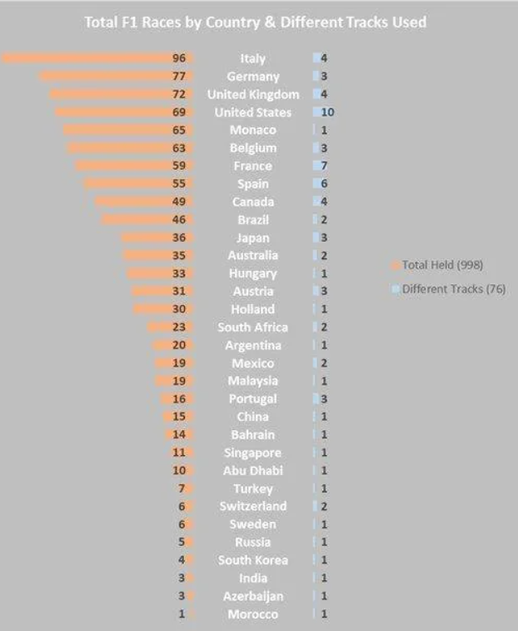

Slide 9
Frequency of Courses Per Year
Course # | Course | 2018 | 2019 | 2020 | 2021 | 2022 | Sub-Total
1 | Abu Dhabi | 0 | 1 | 1 | 1 | 1 | 4
2 | Australia | 1 | 1 | 0 | 0 | 1 | 3
3 | Austria | 1 | 1 | 2 | 2 | 1 | 7
4 | Azerbaijan | 1 | 1 | 0 | 1 | 1 | 4
5 | Bahrain | 1 | 1 | 2 | 1 | 1 | 6
6 | Belgium | 1 | 1 | 1 | 1 | 1 | 5
7 | Brazil | 1 | 1 | 0 | 1 | 1 | 4
8 | Canada | 1 | 1 | 0 | 0 | 1 | 3
9 | China | 1 | 1 | 0 | 0 | 0 | 2
10 | France | 1 | 1 | 0 | 1 | 1 | 4
11 | Germany | 1 | 1 | 1 | 0 | 0 | 3
12 | Great Britain | 1 | 1 | 2 | 1 | 1 | 6
13 | Hungary | 1 | 1 | 1 | 1 | 1 | 5
14 | Italy | 1 | 1 | 3 | 2 | 2 | 9
15 | Japan | 1 | 1 | 0 | 0 | 1 | 3
16 | Mexico | 1 | 1 | 0 | 1 | 1 | 4
17 | Monaco | 1 | 1 | 0 | 1 | 1 | 4
18 | Netherlands | 0 | 0 | 0 | 1 | 1 | 2
19 | Portugal | 0 | 0 | 1 | 1 | 0 | 2
24 | Spain | 1 | 1 | 1 | 1 | 1 | 5
25 | Turkey | 0 | 0 | 1 | 1 | 0 | 2
26 | United Arab Emirates | 1 | 0 | 0 | 0 | 0 | 1
27 | United States | 1 | 1 | 0 | 1 | 2 | 5
 | Sub-Total | 21 | 21 | 17 | 22 | 22 | 103

Slide 10
Climate Variability
 | Air Temperature (Fahrenheit) | Track Temperature (Fahrenheit) | Humidity (%) | Air Pressure (millibar)
Low | 48 | 56.8 | 5 | 779.5
High | 99 | 152.6 | 97.5 | 1023.5
Average | 74.5 | 95.5 | 54.8 | 986.2
Standard Deviation | 41.1 | 49.5 | 18.6 | 49.2

Slide 11
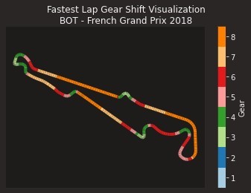
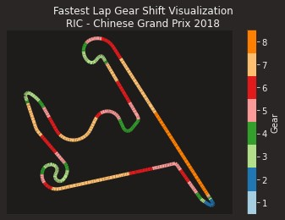
Notes:
Very different course layouts.
Also different geographic areas – North America, Central America, South America, Europe, Middle East, Far East, Australia.

Slide 12
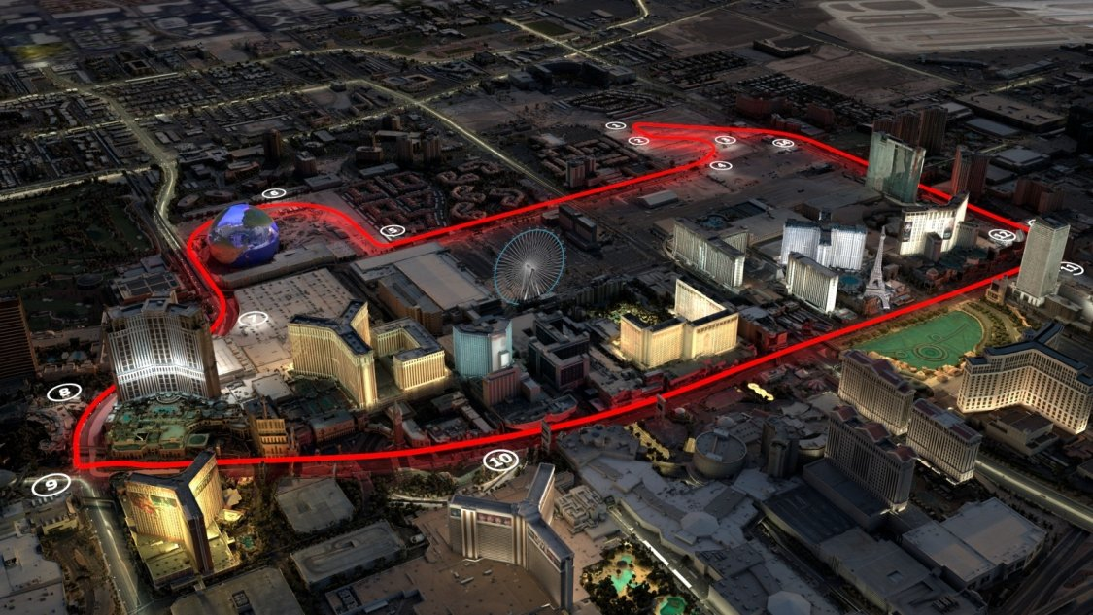
Notes:
Very different course layouts.
Also different geographic areas – North America, Central America, South America, Europe, Middle East, Far East, Australia.

Slide 13
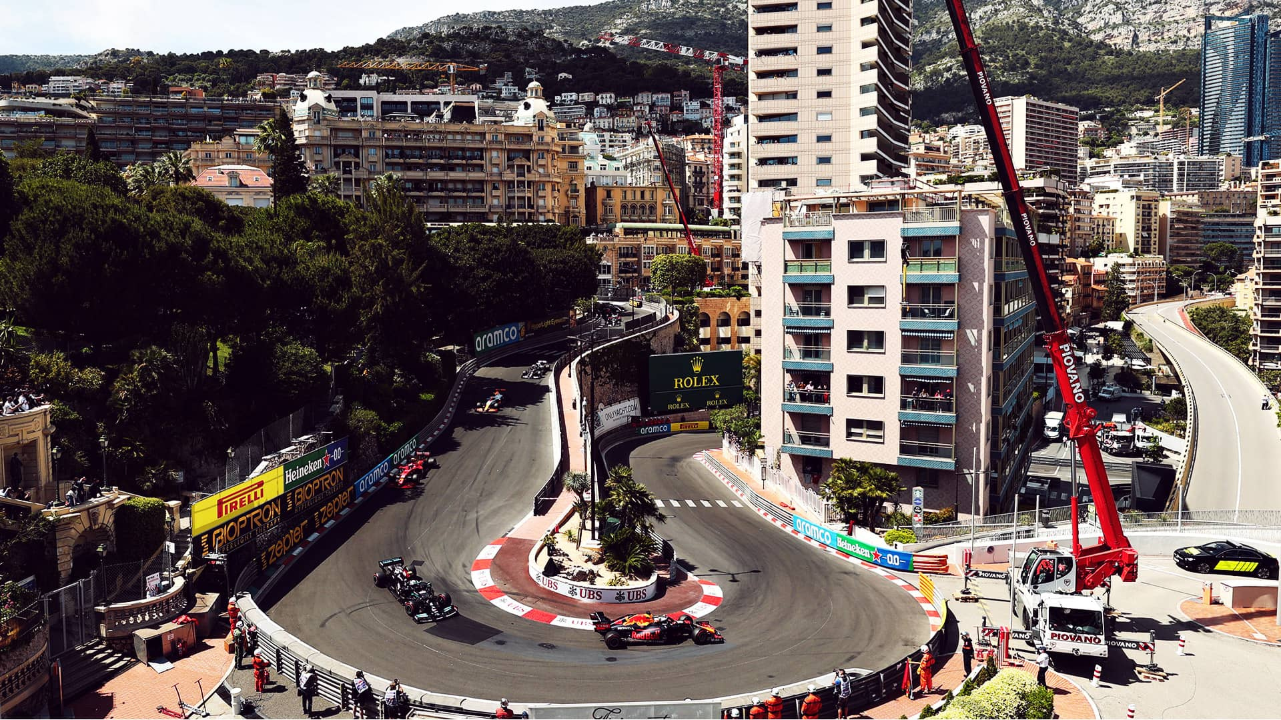
Notes:
In addition to course layout, difference in track vs street. Monaco, here, is on the streets that people use for normal traffic and can include these relatively severe changes in elevation and curves that are not normally found on a race-dedicated track.

Slide 14
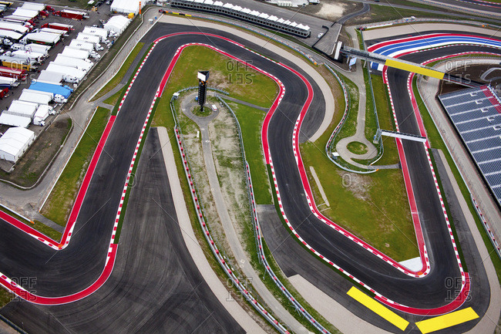

Slide 15
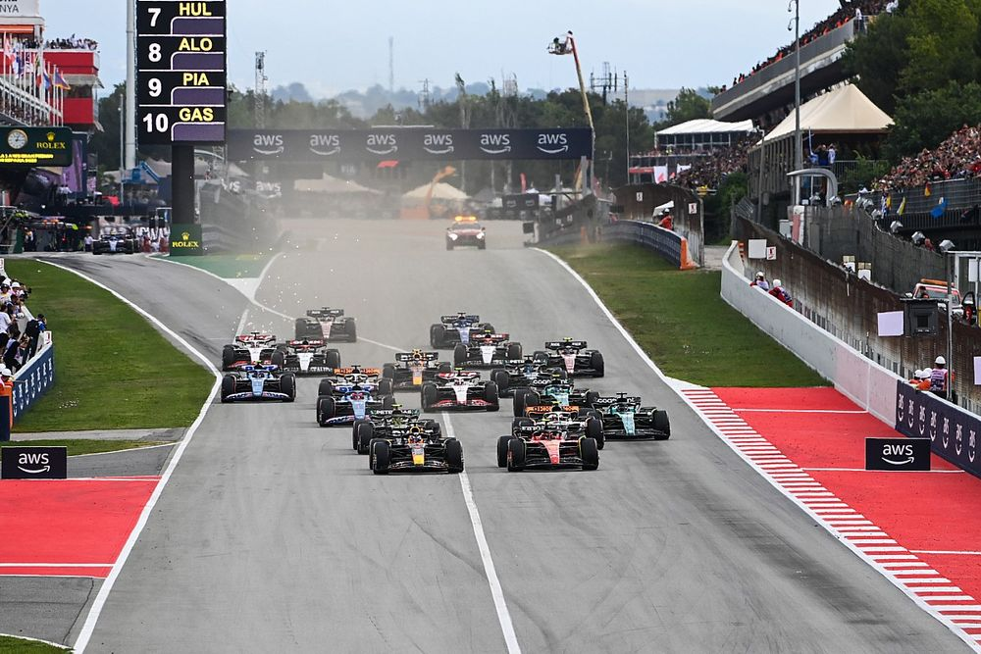
Notes:
A different view of the starting lap that shows the pit lane to the left side of the picture

Slide 16
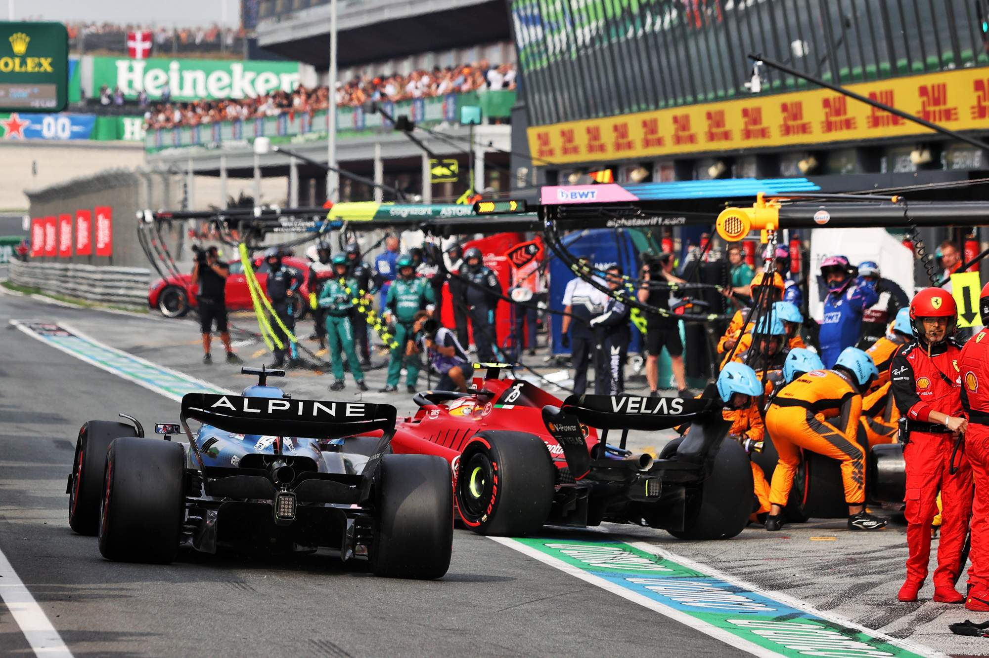

Slide 17
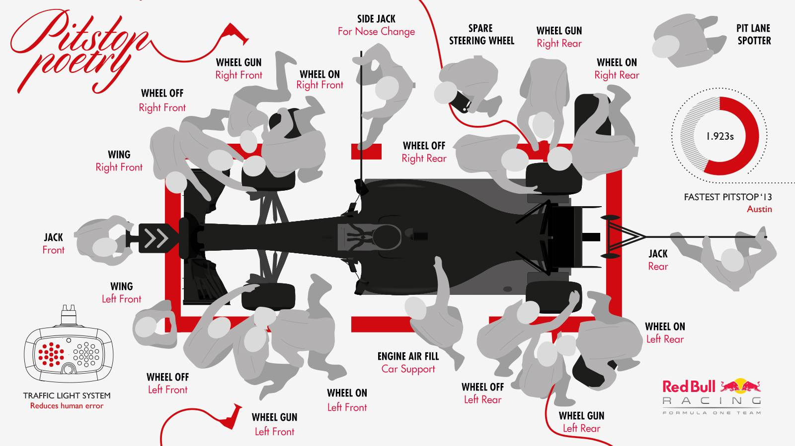

Slide 18
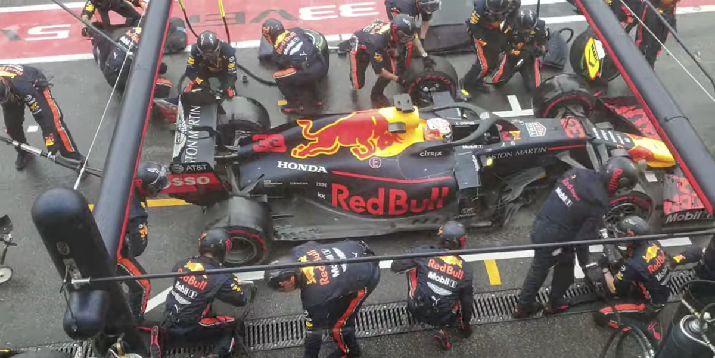
Notes:
https://www.youtube.com/watch?v=stSlnXZ4xnI

Slide 19

Notes:
https://www.youtube.com/watch?v=stSlnXZ4xnI

Slide 20
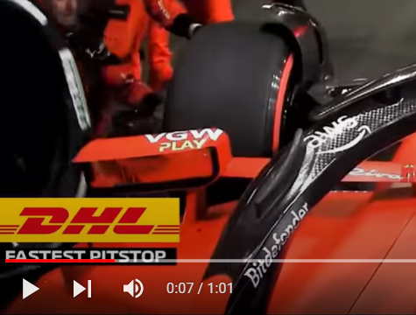
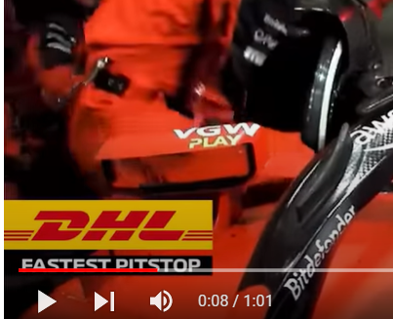

Slide 21
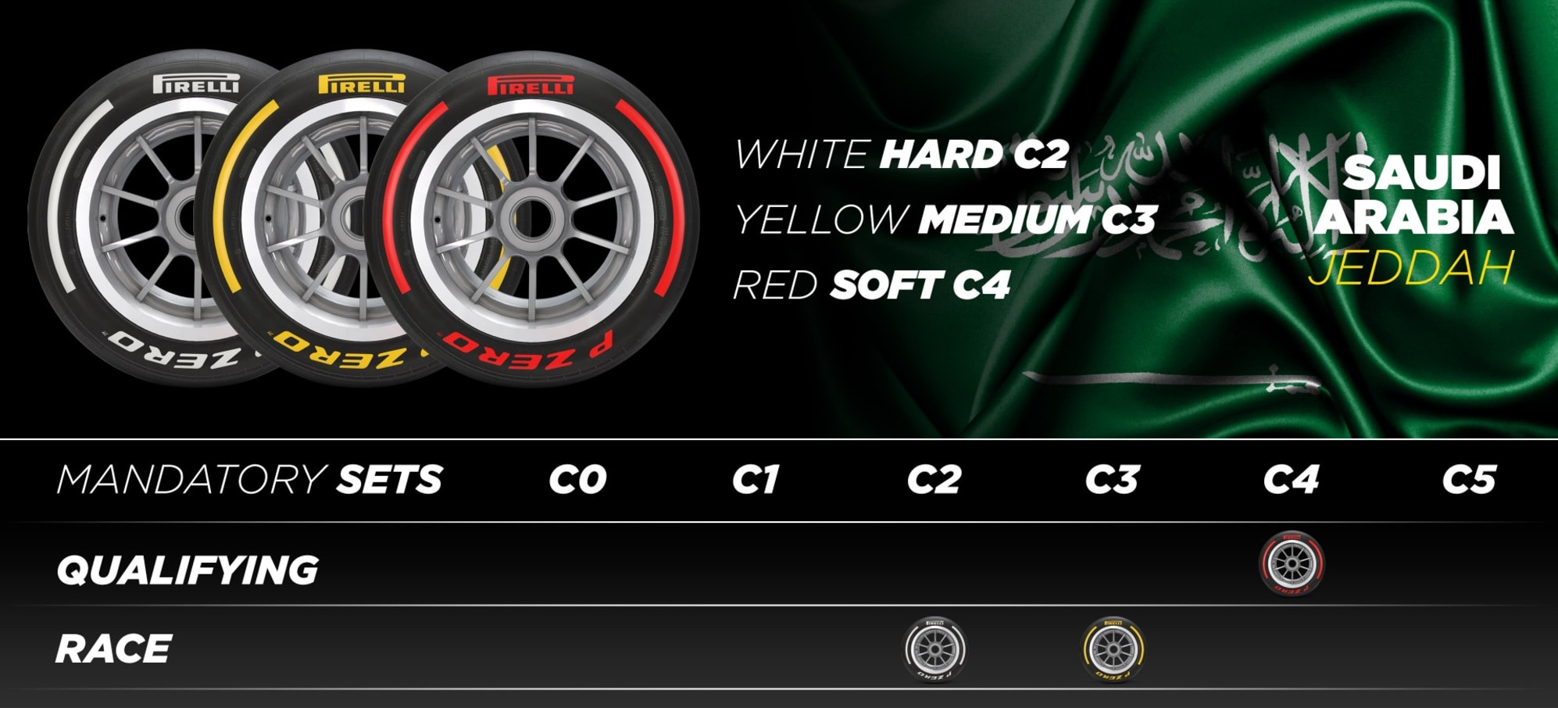
Notes:
https://www.formula1.com/en/latest/article.pirelli-confirm-tyre-choices-for-first-three-f1-races-of-2023-as-new.1xlpcTVaLqw0NeM3aYoyCt.html

Slide 22
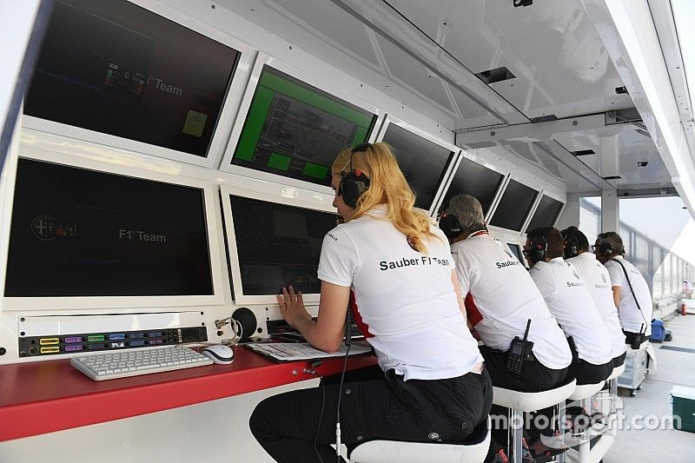

Slide 23
Flags in F1 Races
Flag Color/Type | Meaning
Yellow | Hazard on track.
Green | Normal racing conditions apply.
Red | Session is suspended.
Blue | A faster car is approaching. Move aside (when a driver is being lapped).
Yellow & Red Stripes | Track is slippery.
Black With an Orange Circle | A driver has a mechanical issue and must return to the pits.
Black & White | Warning for unsportsmanlike behavior.
Black | Disqualification.
White | Slower moving vehicles ahead, or miscellaneous vehicles on the track.
Checkered | The session is finished (no new laps may be started).

Slide 24
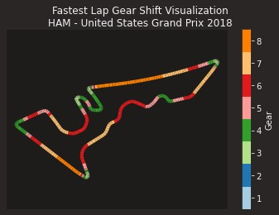
Notes:
Where is the startpoint?
Green in the top left, heading down

Slide 25
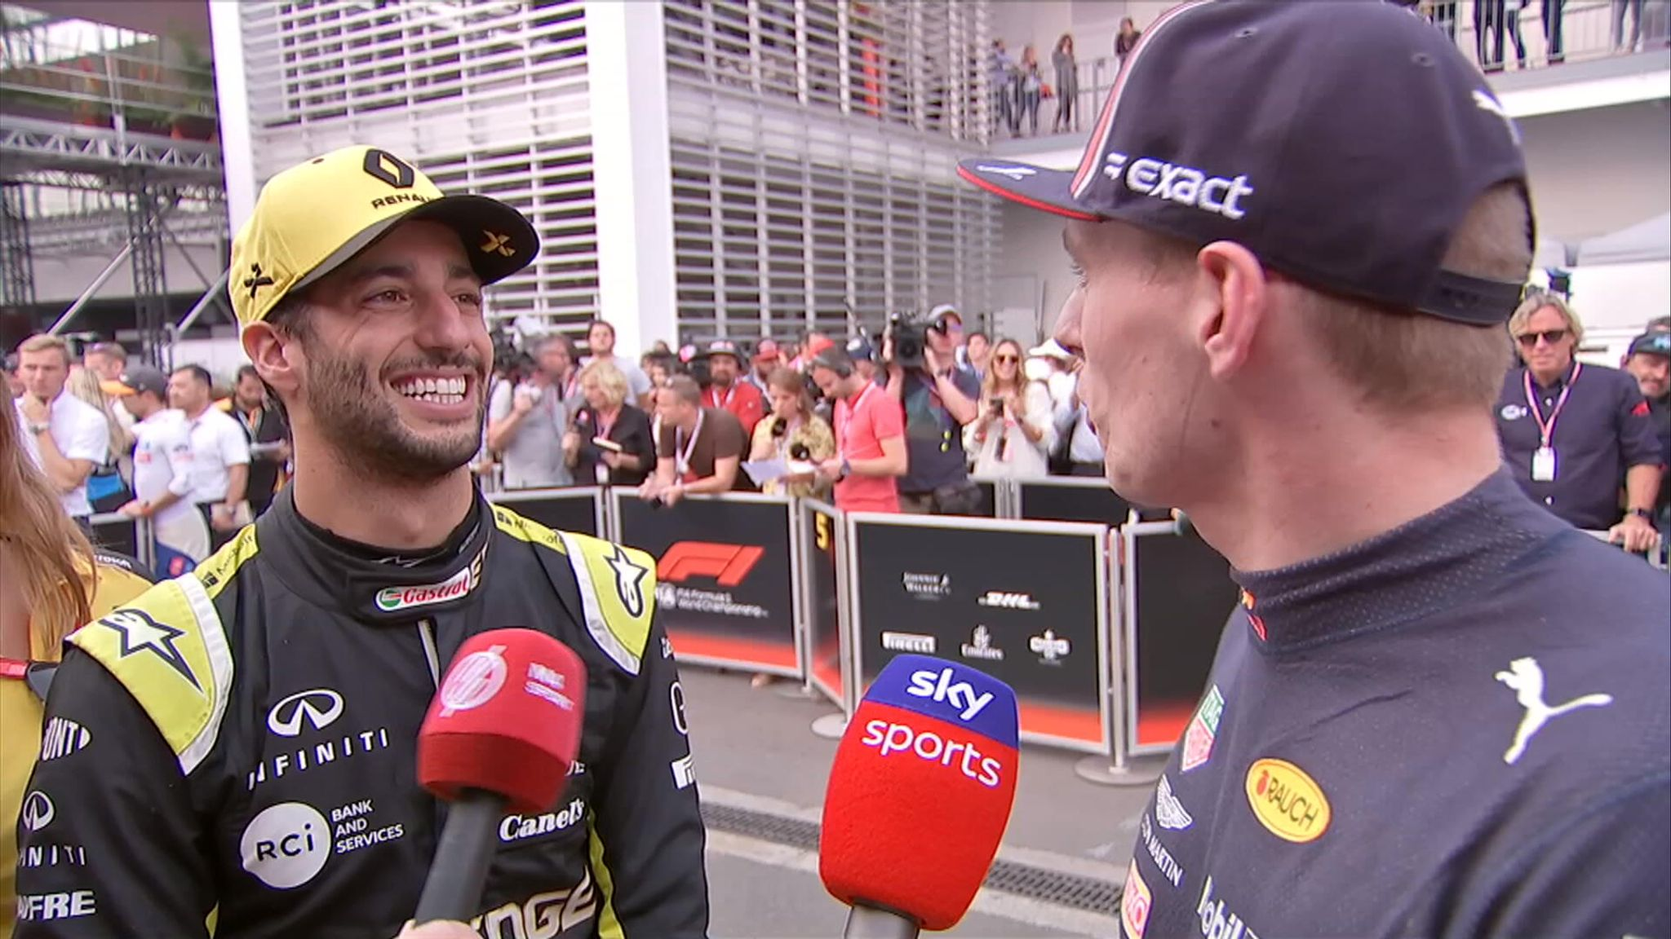
Notes:
I am now ready for questions

Slide 26
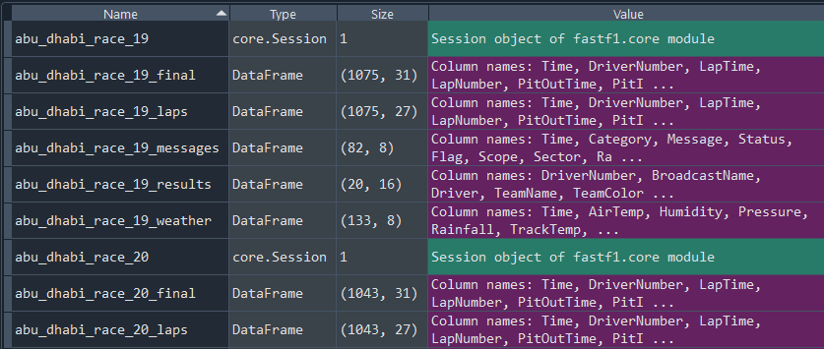

Slide 27
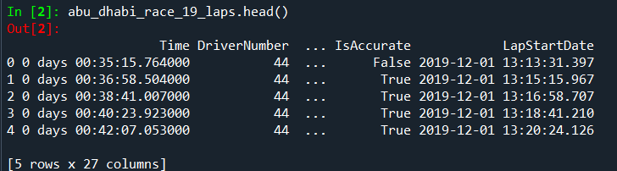
Dataframes: Laps

Slide 28
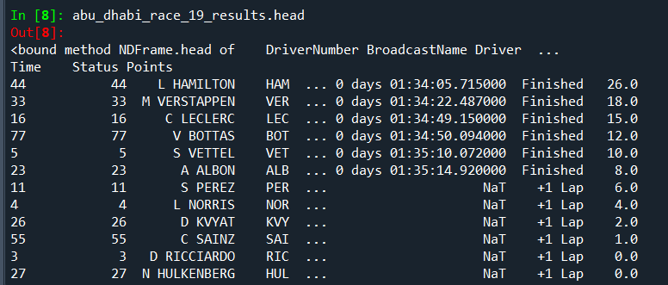
Dataframes: Results

Slide 29
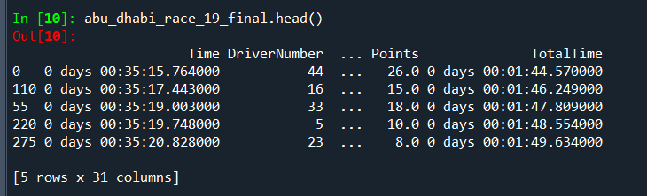
Dataframes: Final
abu_dhabi_race_19_final = pd.merge( abu_dhabi_race_19_laps,
abu_dhabi_race_19_results[[
'Driver', 'GridPosition', 'Position’, 'Points']],
on='Driver’,
how='left')

Slide 30
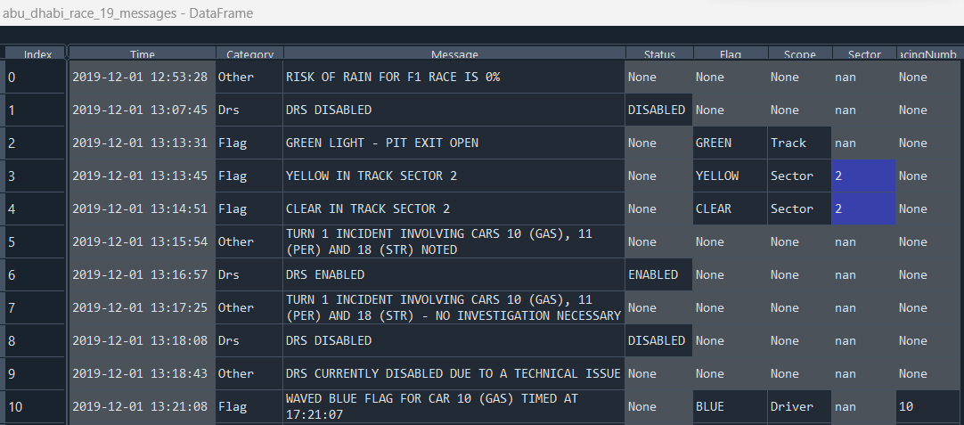
Dataframes: Messages

Slide 31
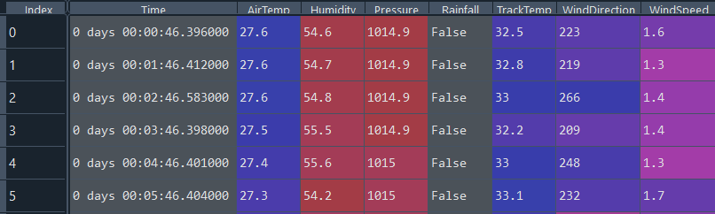
Dataframes: Weather

Slide 32
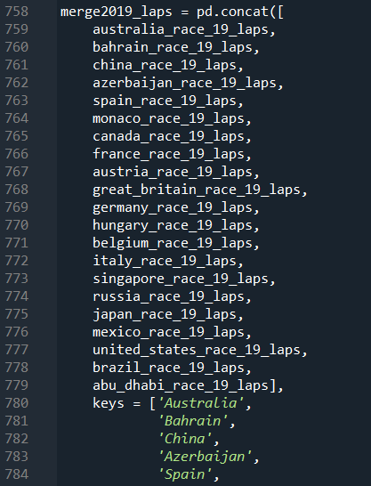
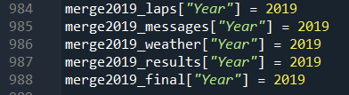
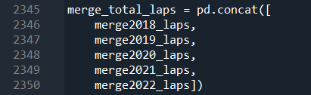
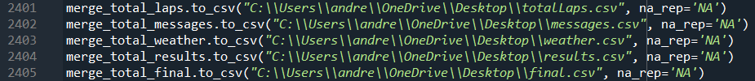
Dataframes: Transformations

Slide 33
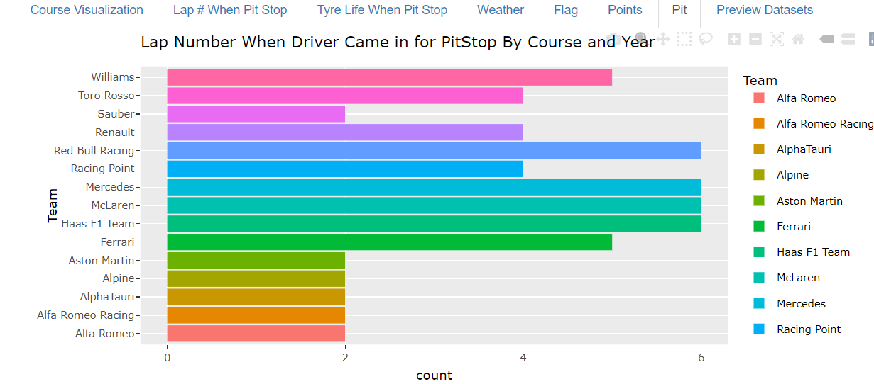
Shiny Visualization

Slide 34
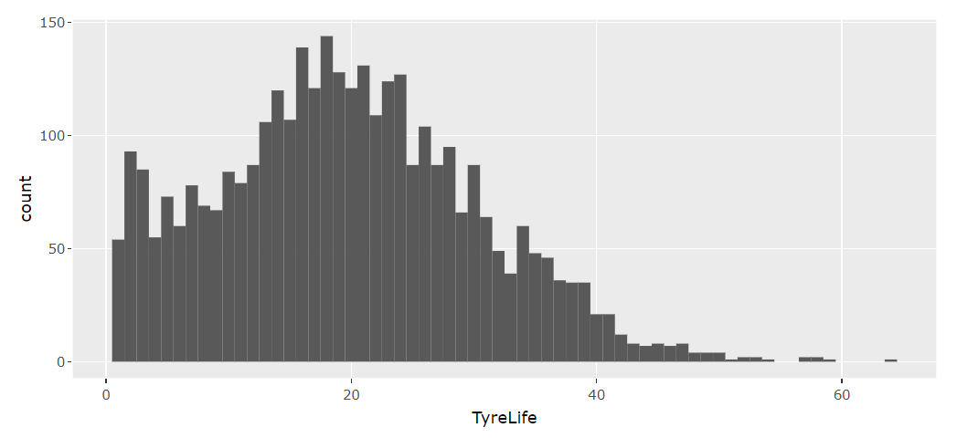
Tire Life When Pit Stop Made

Slide 35
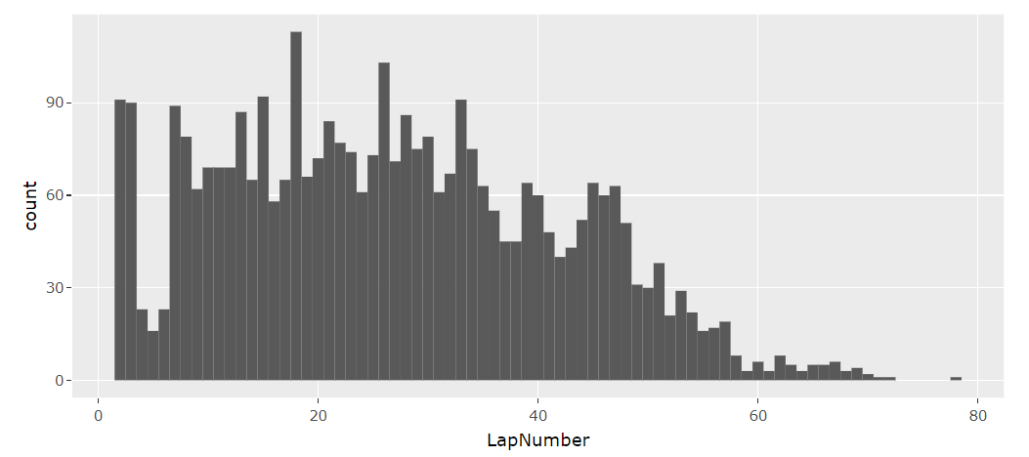
Lap Number When Pit Stop Made

Slide 36

Mean
Lap # When Pit Stop Made 14.833
Grouping by tire type 0.479
Variance
Lap # When Pit Stop Made 46.567
Grouping by tire type 0.297

Slide 37
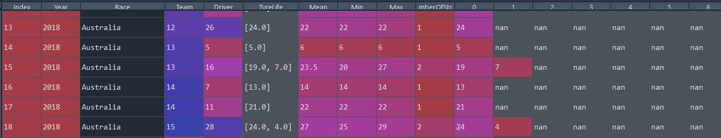
Pit Stop Data Frame

Slide 38
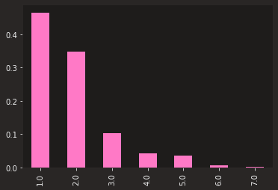
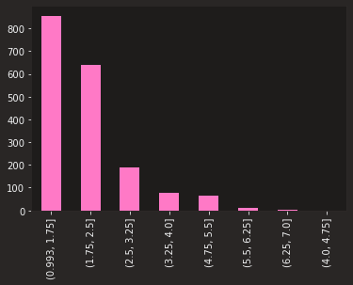
Actual and Normalized# of Pit Stops Per Race

Slide 39


Slide 40
Variable | Coef | Std Erro | Z | P | 0.025 | 0.975
TyreLife | 0.1357 | 0.002 | 61.849 | 0 | 0.131 | 0.14
Cumulative | 0.0006 | 8.62E-06 | 74.35 | 0 | 0.001 | 0.001
CumulativeLap | 0.001 | 1.31E-05 | 73.849 | 0 | 0.001 | 0.001
CumulativePit | 0.0015 | 2.16E-05 | 68.217 | 0 | 0.001 | 0.002
Sector1TimeSeconds | 0.0372 | 0.001 | 65.751 | 0 | 0.036 | 0.038
Sector2TimeSeconds | 0.05 | 0.001 | 68.866 | 0 | 0.049 | 0.051
Sector3TimeSeconds | 0.0371 | 0.001 | 67.139 | 0 | 0.036 | 0.038
PitTime | 0.0025 | 4.29E-05 | 58.611 | 0 | 0.002 | 0.003
PitOutTimeSeconds | 0 | 0 | nan | nan | 0 | 0
PitInTimeSeconds | 0.0004 | 5.19E-06 | 76.482 | 0 | 0 | 0
Stint | 1.0934 | 0.015 | 72.19 | 0 | 1.064 | 1.123
Gap | 0.0027 | 0 | 13.765 | 0 | 0.002 | 0.003
Fresh Tyre - FALSE | 2.8084 | 0.05 | 56.027 | 0 | 2.71 | 2.907
Fresh Tyre - True | 2.5713 | 0.056 | 45.564 | 0 | 2.461 | 2.682
TeamCat | 0.3661 | 0.007 | 54.139 | 0 | 0.353 | 0.379
DriverCat | 0.1939 | 0.003 | 60.429 | 0 | 0.188 | 0.2
DriverNumberCat | 0.1997 | 0.003 | 59.707 | 0 | 0.193 | 0.206
TrackStatusCat | 0.5792 | 0.01 | 55.519 | 0 | 0.559 | 0.6
Notes:
Poisson

Slide 41
Variable | coef | std err | z | P>|z| | [0.025 | 0.975]
Stint | 1.0922 | 0.031 | 35.145 | 0 | 1.031 | 1.153
Stint_alpha | 1.2417 | 0.216 | 5.747 | 0 | 0.818 | 1.665
TyreLife | 0.1365 | 0.005 | 25.987 | 0 | 0.126 | 0.147
TyreLife_alpha | 1.987 | 0.281 | 7.069 | 0 | 1.436 | 2.538
Sector1TimeSeconds | 0.0374 | 0.001 | 28.658 | 0 | 0.035 | 0.04
Sector1TimeSeconds_alpha | 1.6397 | 0.271 | 6.06 | 0 | 1.109 | 2.17
Sector2TimeSeconds | 0.0506 | 0.001 | 34.544 | 0 | 0.048 | 0.053
Sector2TimeSeconds_alpha | 1.123 | 0.21 | 5.339 | 0 | 0.711 | 1.535
Sector3TimeSeconds | 0.0374 | 0.001 | 30.331 | 0 | 0.035 | 0.04
Sector3TimeSeconds_alpha | 1.4451 | 0.255 | 5.665 | 0 | 0.945 | 1.945
DriverCat | 0.1984 | 0.008 | 25.492 | 0 | 0.183 | 0.214
DriverCat_alpha | 1.8954 | 0.291 | 6.504 | 0 | 1.324 | 2.467
DriverNumberCat | 0.2015 | 0.008 | 24.005 | 0 | 0.185 | 0.218
DriverNumberCat_alpha | 2.0324 | 0.312 | 6.513 | 0 | 1.421 | 2.644
TeamCat | 0.3762 | 0.017 | 21.984 | 0 | 0.343 | 0.41
TeamCat_alpha | 2.2141 | 0.334 | 6.636 | 0 | 1.56 | 2.868
FreshTyreFalse | 2.7766 | 0.073 | 38.12 | 0 | 2.634 | 2.919
FreshTyreTrue | 2.6103 | 0.079 | 33.005 | 0 | 2.455 | 2.765
FreshTyre_alpha | 0.4366 | 0.137 | 3.191 | 0.001 | 0.168 | 0.705
Notes:
Consul’s Poisson

Slide 42

Notes:
Famoye’s Poisson

Slide 43
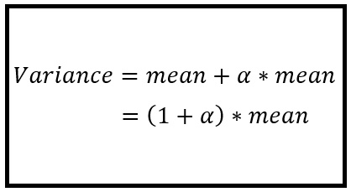
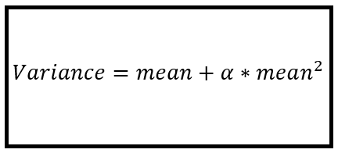
Negative Binomial: Which Model
Notes:
https://timeseriesreasoning.com/contents/negative-binomial-regression-model/
http://faculty.econ.ucdavis.edu/faculty/cameron/racd2/

Slide 44
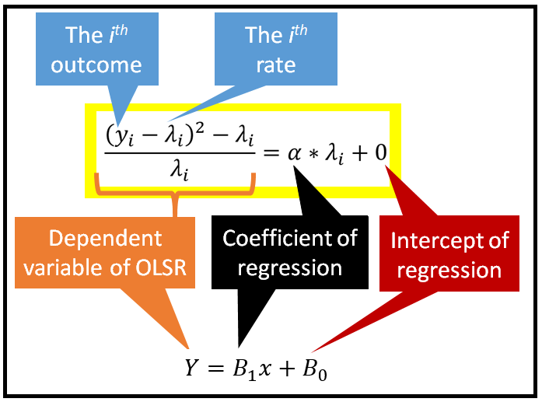
Negative Binomial 2
Notes:
https://timeseriesreasoning.com/contents/negative-binomial-regression-model/
http://faculty.econ.ucdavis.edu/faculty/cameron/racd2/

Slide 45

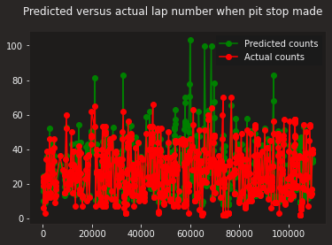
Notes:
https://www.npr.org/2023/01/16/1149232763/this-is-fine-meme-anniversary-gunshow-web-comic

Slide 47
Variable | Importance
Sector1TimeSeconds' | 9.421%.
CumulativeLap' | 8.47%.
Sector2TimeSeconds' | 6.959%.
Sector3TimeSeconds' | 6.898%.
CumulativePit' | 5.435%.
TyreLife' | 4.298%.
EndPosition' | 2.19%.
TrackStatusCat' | 16.64%.
Cumulative' | 11.057%.
PitTime' | 10.172%.
PitInTimeSeconds' | 10.074%.
DriverCat' | 1.543%.
Gap' | 1.23%.
Points' | 1.067%.
Stint' | 1.043%.
Notes:
Random Forest

Slide 48



Quasi-Poisson and Others
Notes:
https://cran.r-project.org/web/packages/pscl/vignettes/countreg.pdf
https://flexmix.nl/
https://stock.adobe.com/search?k=gee
https://www.google.com/imgres?imgurl=https%3A%2F%2Fwww.abbreviations.com%2Fimages%2F1686210_NLME.png&tbnid=xr2qAERW6FHBuM&vet=12ahUKEwjY39ilkub_AhXwhbAFHR3EA-EQMygBegUIARC_AQ..i&imgrefurl=https%3A%2F%2Fwww.abbreviations.com%2FNLME&docid=ma_2annBzs_ZyM&w=500&h=270&itg=1&q=nlme%20word&ved=2ahUKEwjY39ilkub_AhXwhbAFHR3EA-EQMygBegUIARC_AQ

Slide 49
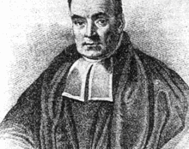
Bayesian Analysis
Simulate the Normal model
Posterior predictive check
Check predictive power
Simulate posterior predictive models
Plot the posterior predictive models
Summarize Cross Validated Model
Notes:
https://cran.r-project.org/web/packages/pscl/vignettes/countreg.pdf
https://flexmix.nl/
https://stock.adobe.com/search?k=gee
https://www.google.com/imgres?imgurl=https%3A%2F%2Fwww.abbreviations.com%2Fimages%2F1686210_NLME.png&tbnid=xr2qAERW6FHBuM&vet=12ahUKEwjY39ilkub_AhXwhbAFHR3EA-EQMygBegUIARC_AQ..i&imgrefurl=https%3A%2F%2Fwww.abbreviations.com%2FNLME&docid=ma_2annBzs_ZyM&w=500&h=270&itg=1&q=nlme%20word&ved=2ahUKEwjY39ilkub_AhXwhbAFHR3EA-EQMygBegUIARC_AQ

Slide 50
Questions?
Notes:
https://cran.r-project.org/web/packages/pscl/vignettes/countreg.pdf
https://flexmix.nl/
https://stock.adobe.com/search?k=gee
https://www.google.com/imgres?imgurl=https%3A%2F%2Fwww.abbreviations.com%2Fimages%2F1686210_NLME.png&tbnid=xr2qAERW6FHBuM&vet=12ahUKEwjY39ilkub_AhXwhbAFHR3EA-EQMygBegUIARC_AQ..i&imgrefurl=https%3A%2F%2Fwww.abbreviations.com%2FNLME&docid=ma_2annBzs_ZyM&w=500&h=270&itg=1&q=nlme%20word&ved=2ahUKEwjY39ilkub_AhXwhbAFHR3EA-EQMygBegUIARC_AQ

